Slide 1
Creational Patterns

Slide 2
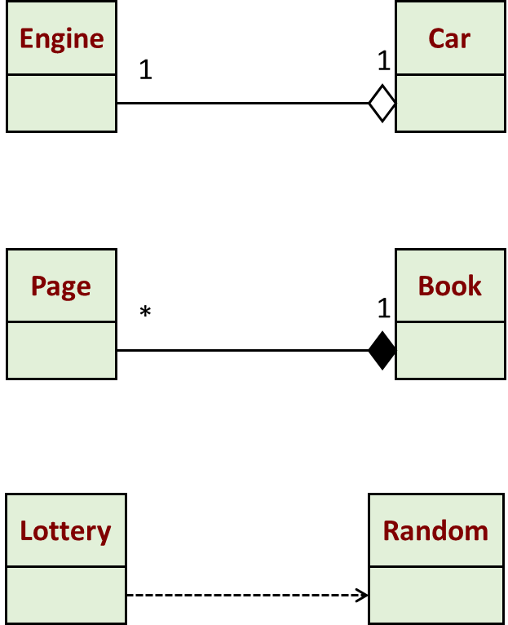
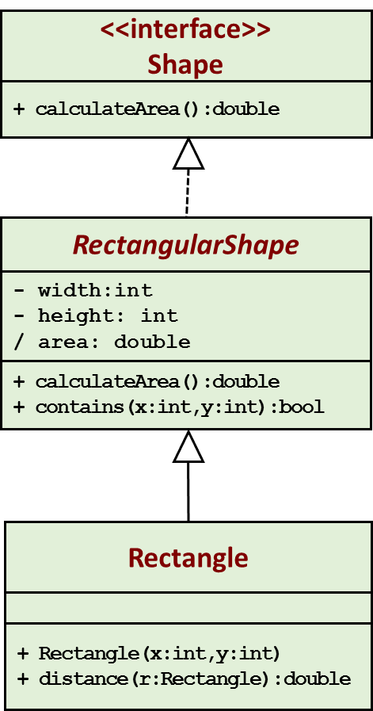
UML Revisited
Aggregation: “is part of”
Composition: “is entirely made of”
Generalization
Dependency: “uses”

Slide 3
Creational Patterns to be Covered
Factory method
Abstract factory
Builder
Singleton
Examples taken from:
https://www.tutorialspoint.com/design_pattern/
https://www.javatpoint.com/design-patterns-in-java

Slide 4
Factory Method
Intent | Define an interface for creating an object, but let subclasses decide which class to instantiate. Factory Method lets a class defer instantiation to subclasses.
Problem | A framework needs to standardize the architectural model for a range of applications, but allow for individual applications to define their own domain objects and provide for their instantiation. Enable the creator to defer product creation to sub-class.

Slide 5
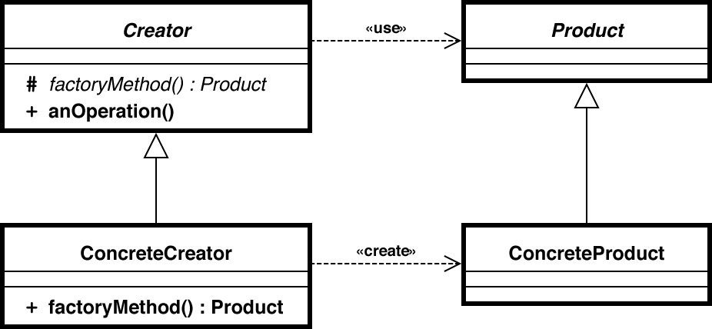
Solution

Slide 6
Example: Drawing
<<interface>>
Shape
Client
+ draw()
Circle
Square
Rectangle
ShapeFactory
+ draw()
+ draw()
+ draw()
+drawShape(type):Shape

Slide 7
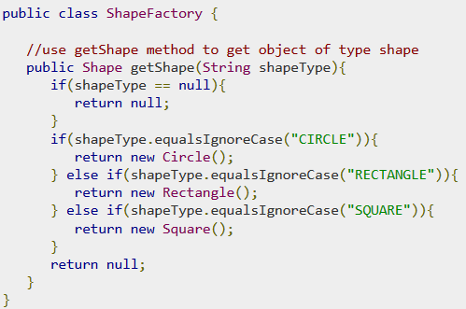
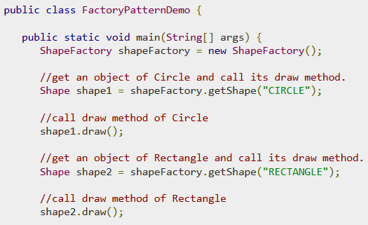
public interface Shape {
void draw();
}
public class Rectangle implements Shape {
@Override
public void draw() {
System.out.println("Inside Rectangle::draw() method.");
}
}
Similar implementation for Square and Circle

Slide 8
Example: Kiosk
<<interface>>
PaymentProcessor
Kiosk
+ processPayment()
GetPayment
Cash
CreditCard
Coupon
+getProcessor(type):
PaymentProcessor
+ prcessPayment()
+ prcessPayment()
+ prcessPayment()

Slide 9
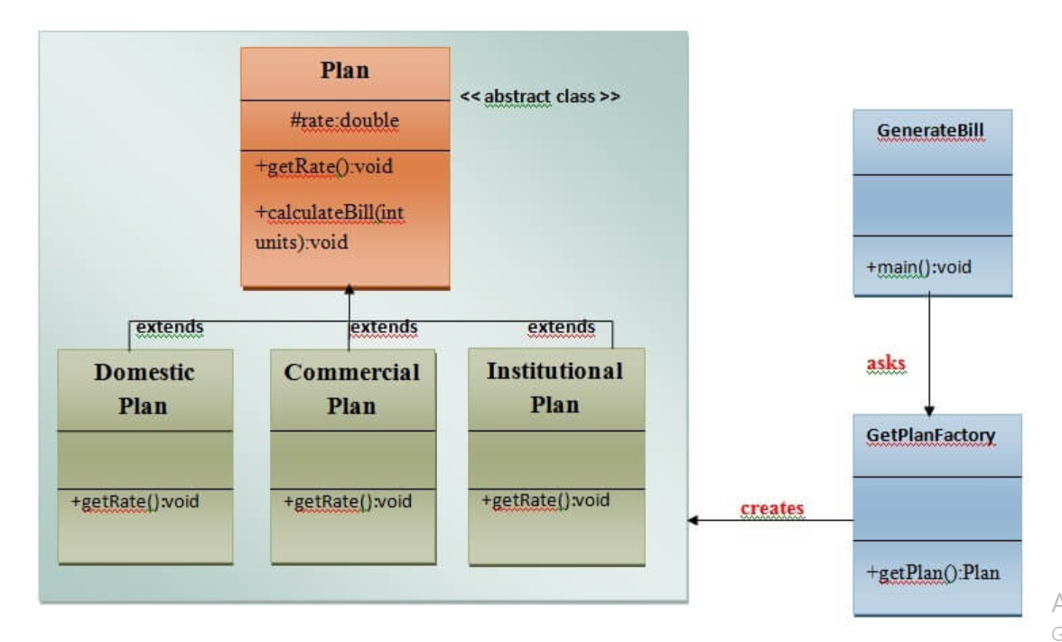
Factory

Slide 10
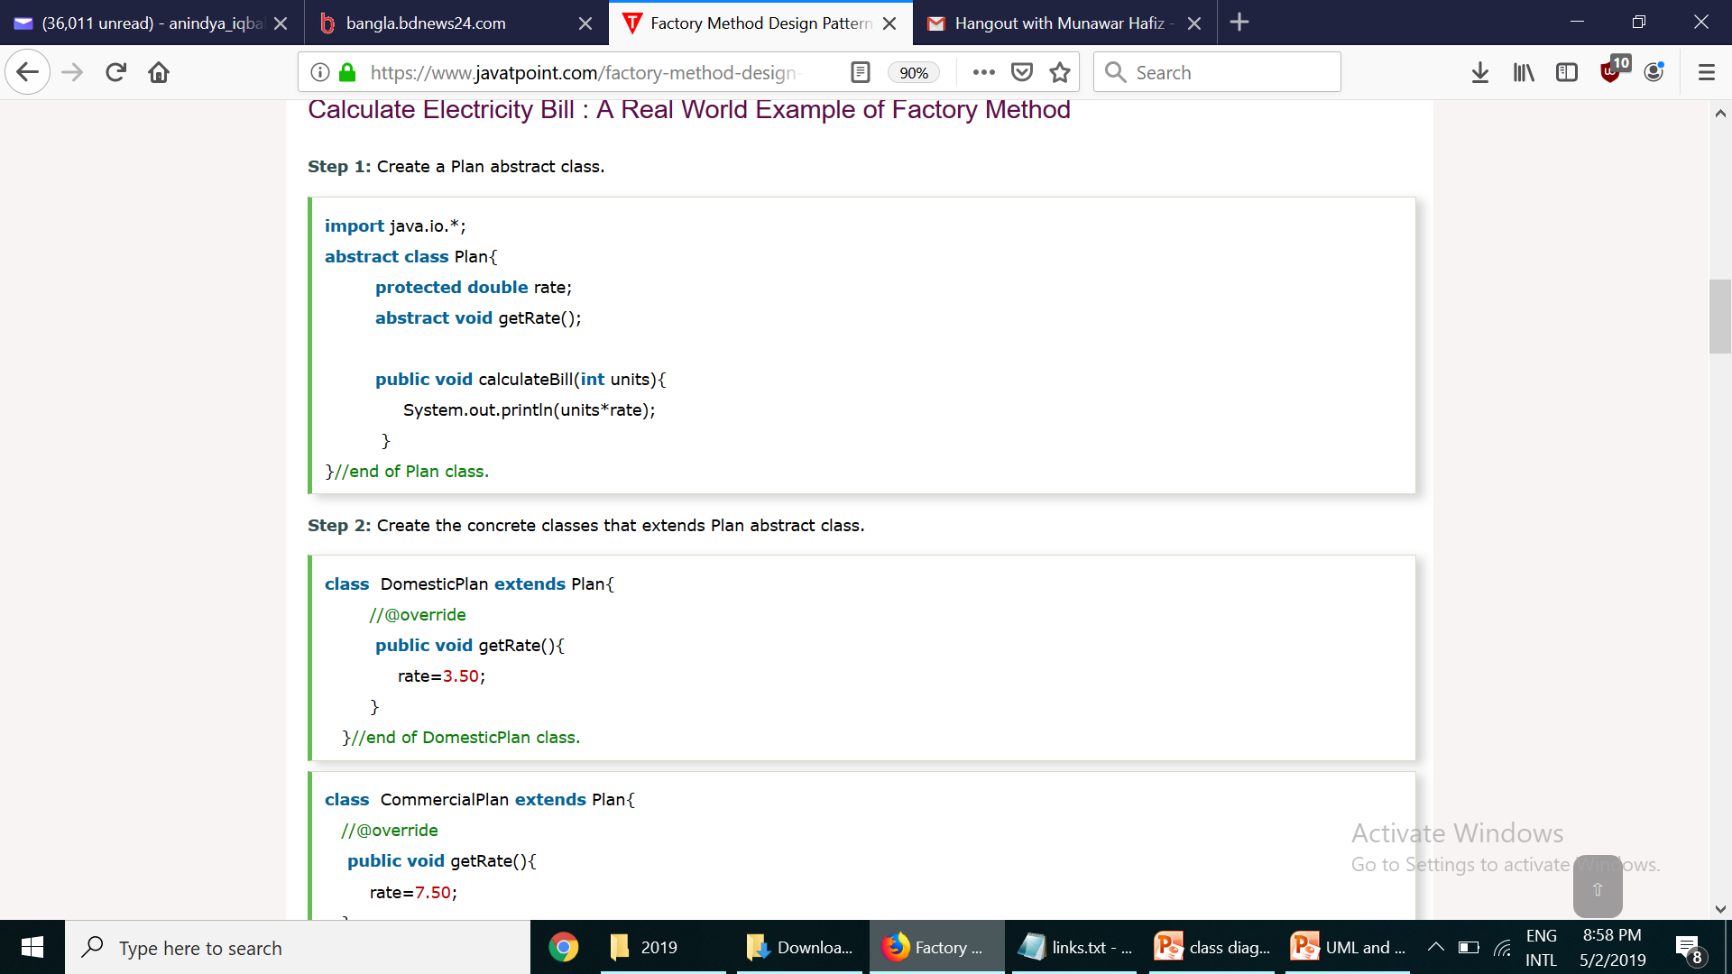
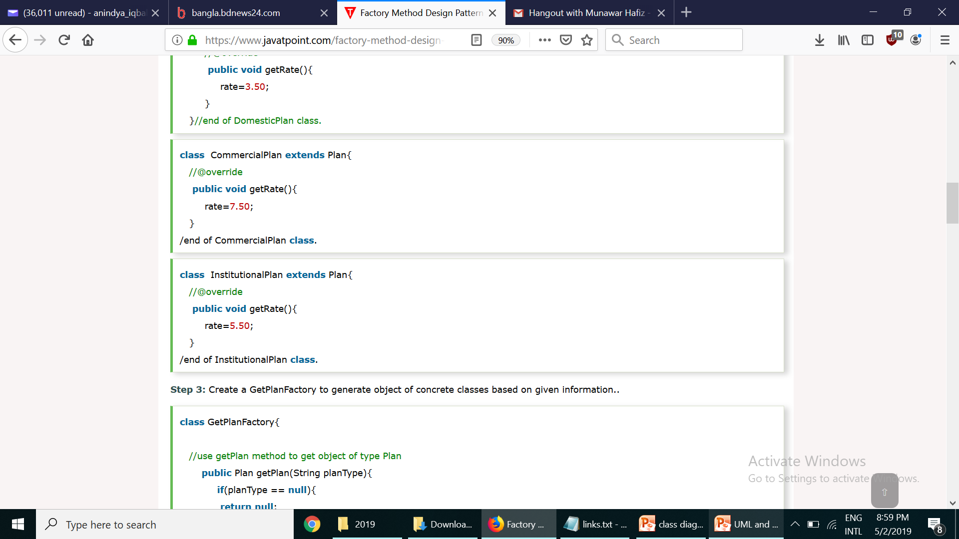

Slide 11
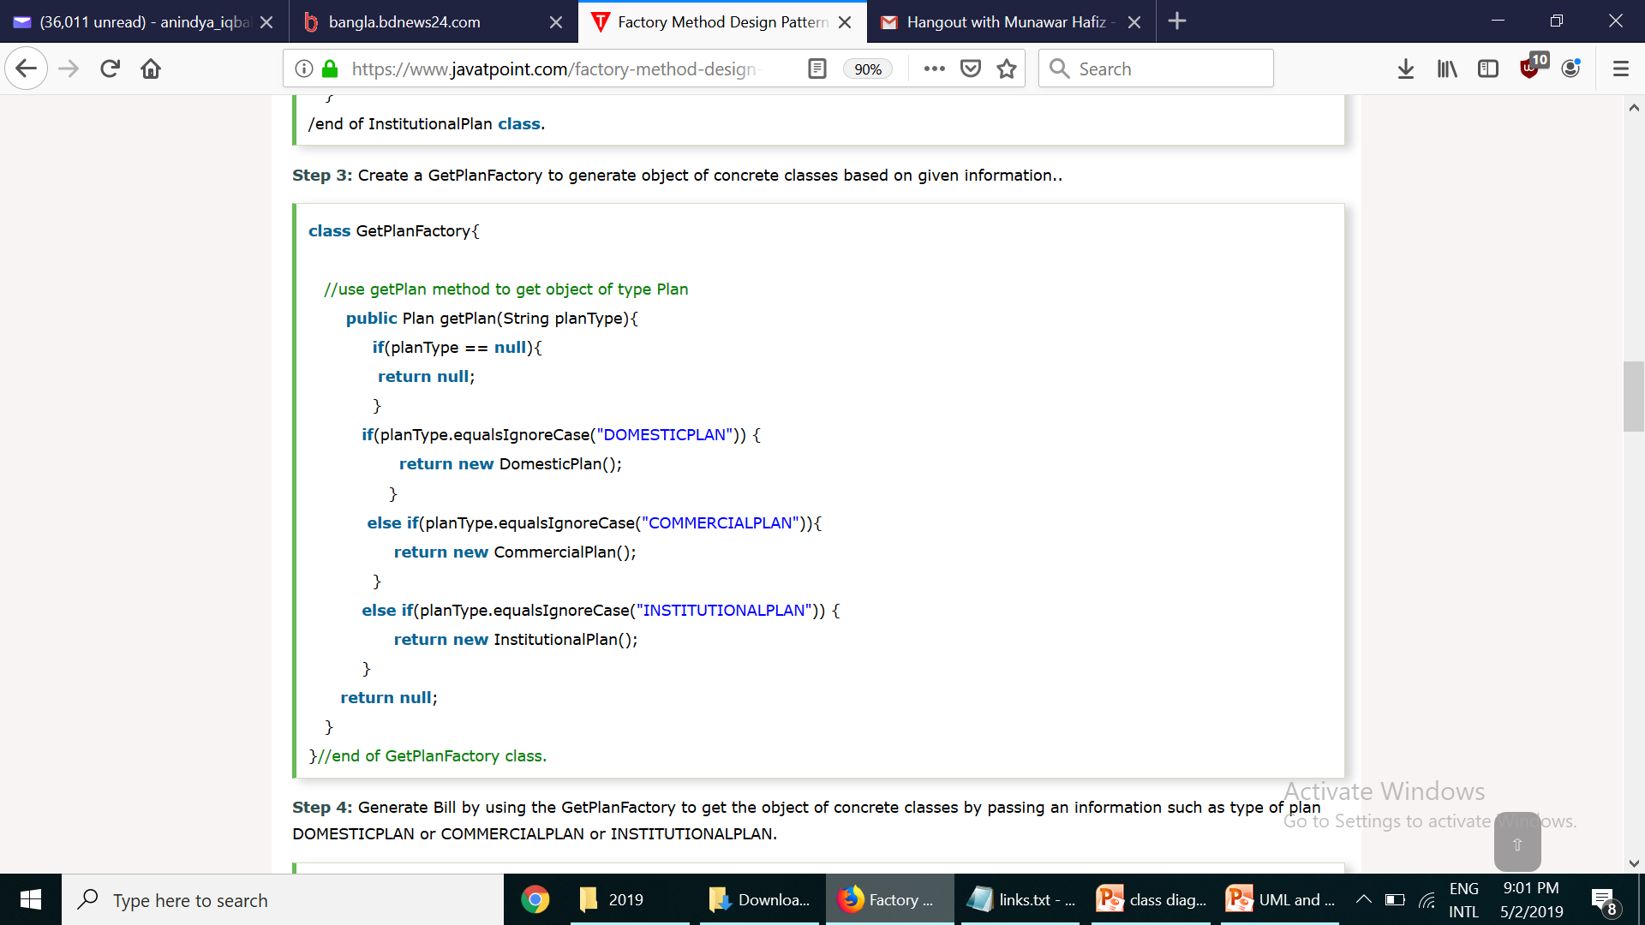
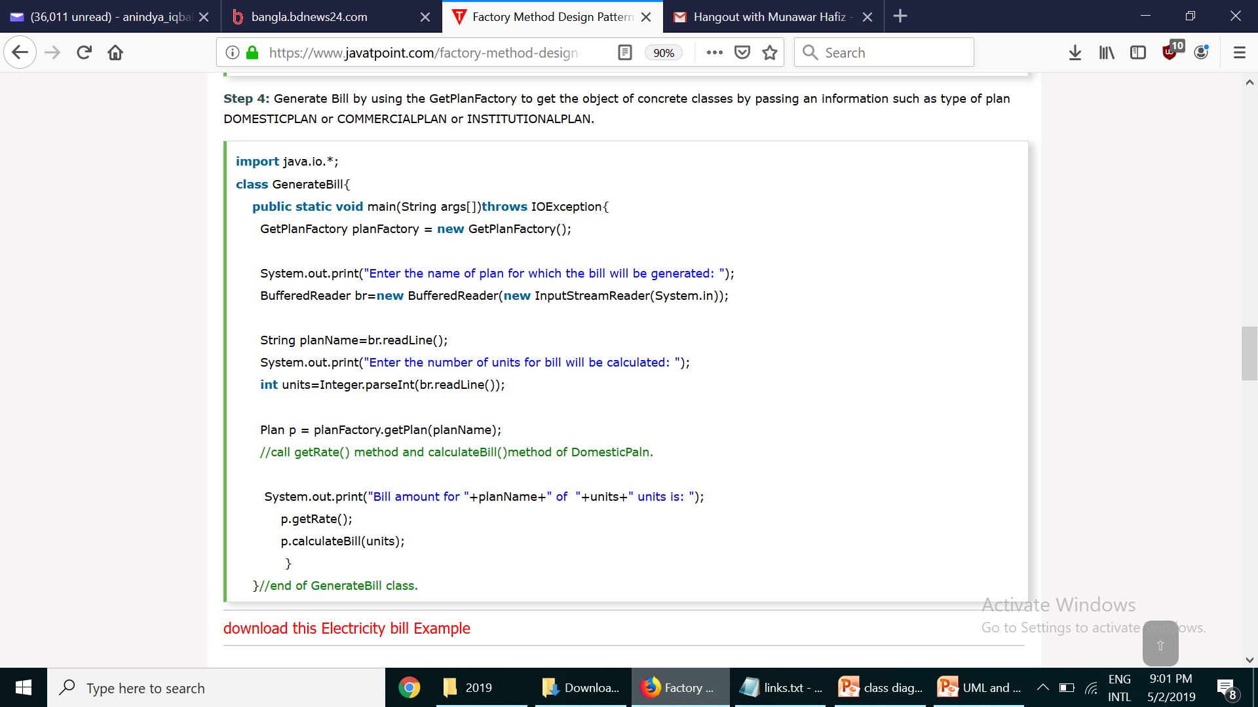

Slide 12
Consequences
Factory design pattern provides approach to code for interface rather than implementation.
Factory pattern removes the instantiation of actual implementation classes from client code. Factory pattern makes our code more robust, less coupled and easy to extend. For example, we can easily change lower class implementation because client program is unaware of this.
Factory pattern provides abstraction between implementation and client classes through inheritance.

Slide 13
Abstract Factory
Intent | Provide an interface for creating families of related or dependent objects without specifying their concrete classes.
Problem | A portable application needs to encapsulate platform dependencies Consider an application that support multiple look and feels. An application need to work with multiple types of DBMS

Slide 14
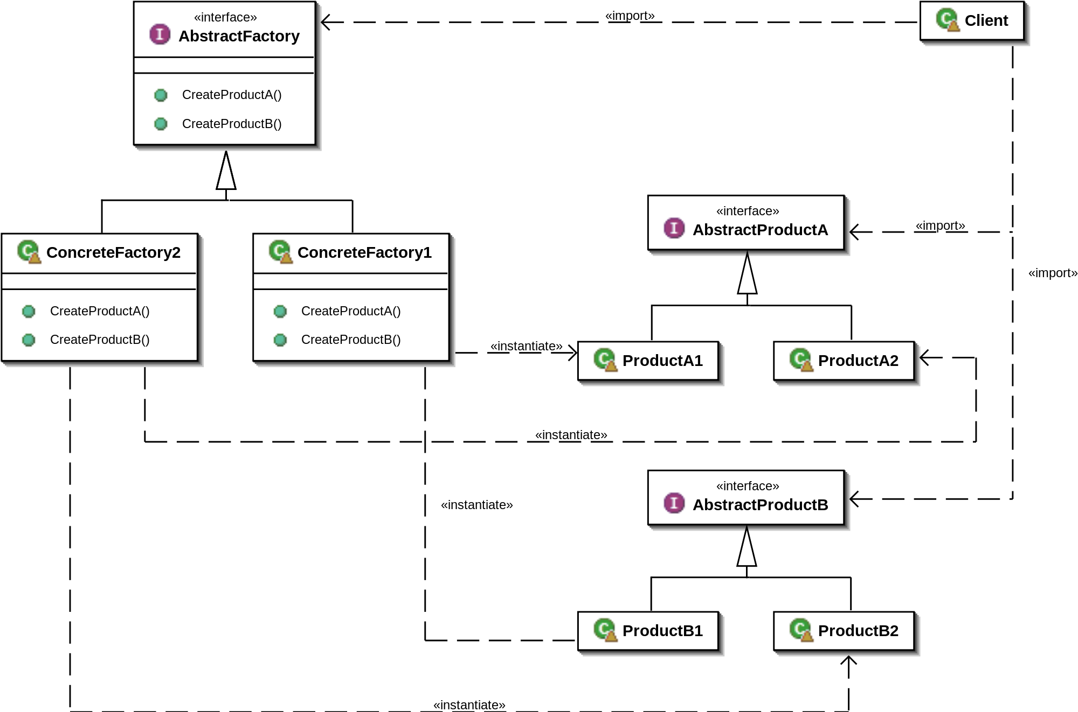
Solution

Slide 15
Example: Car Factory
<<interface>>
HondaFactory
Client
+ createEngine()
+ createTrans()
Engine
CivicFactory
AccordFactory
+ createEngine()
+ createTrans()
+ createEngine()
+ createTrans()
CivicEngine
AccordEngine
Transmission
CivicTrans
AccordTrans

Slide 16
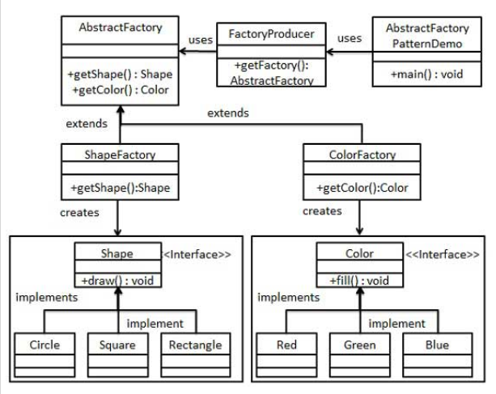
https://www.tutorialspoint.com/design_pattern/design_pattern_quick_guide.htm

Slide 17
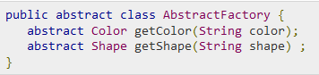
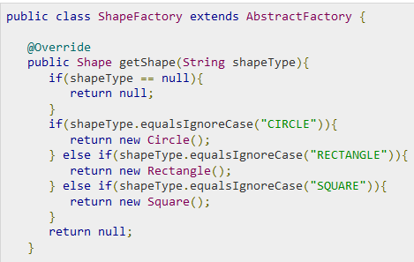

Slide 18
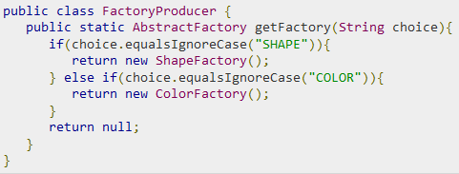
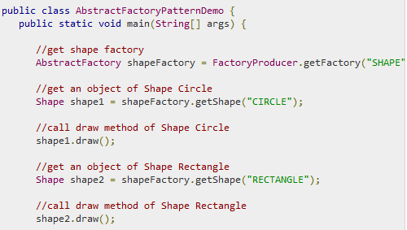

Slide 19
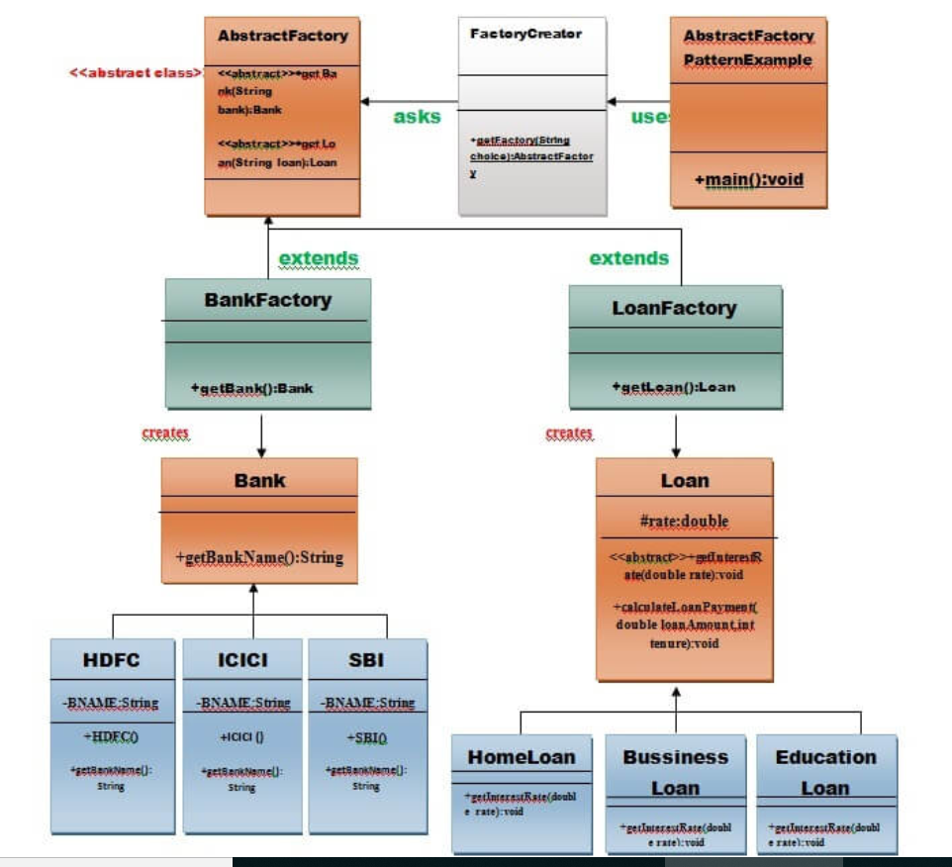
Abstract Factory

Slide 20
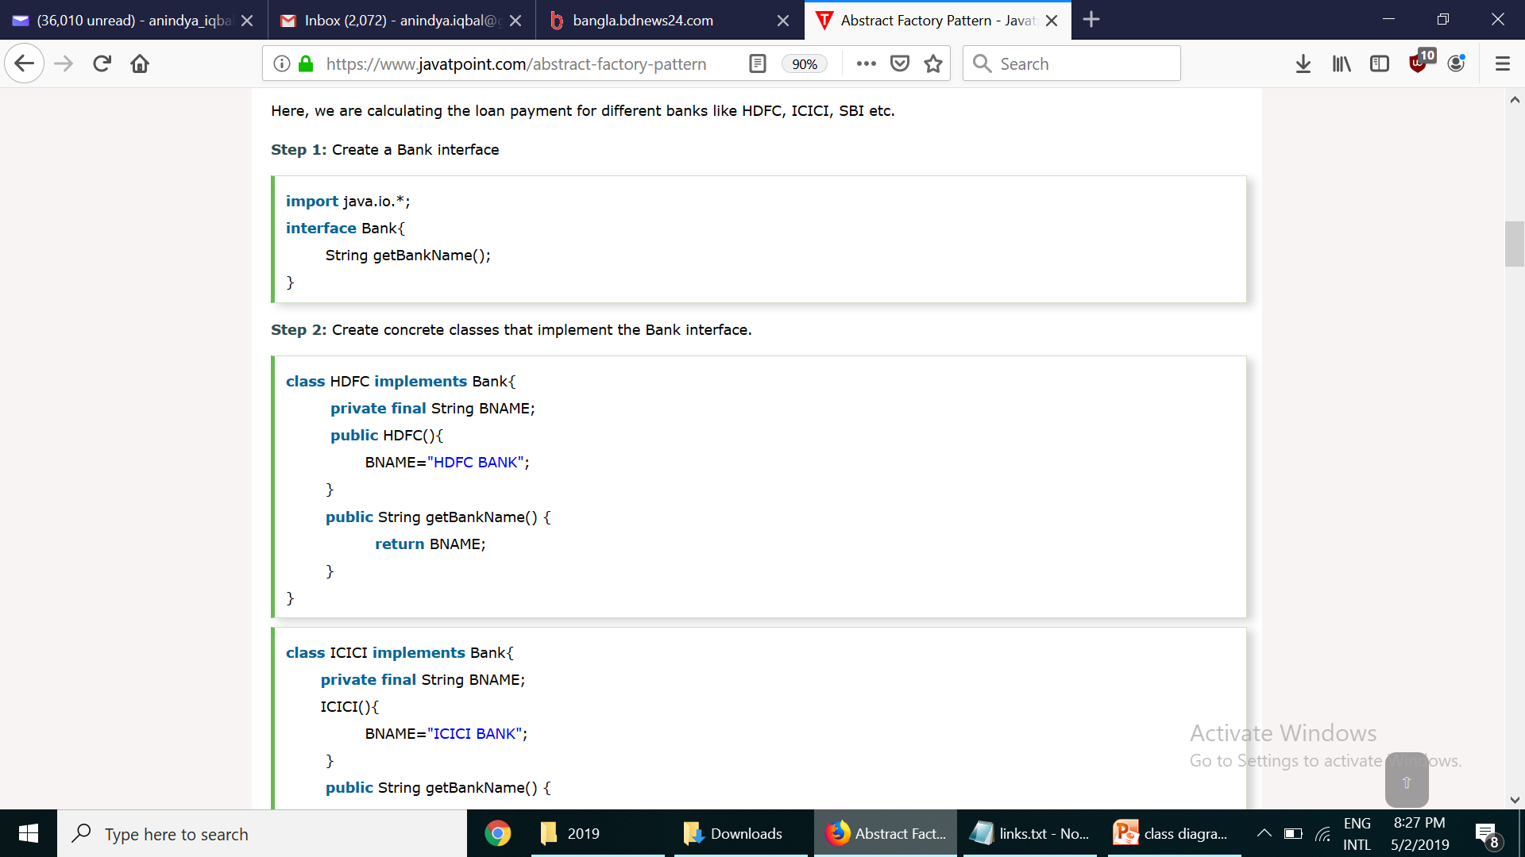
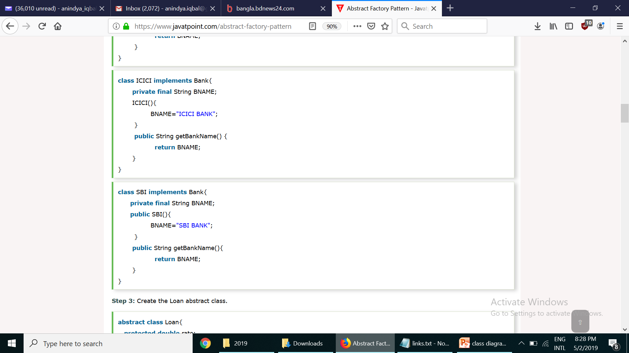

Slide 21
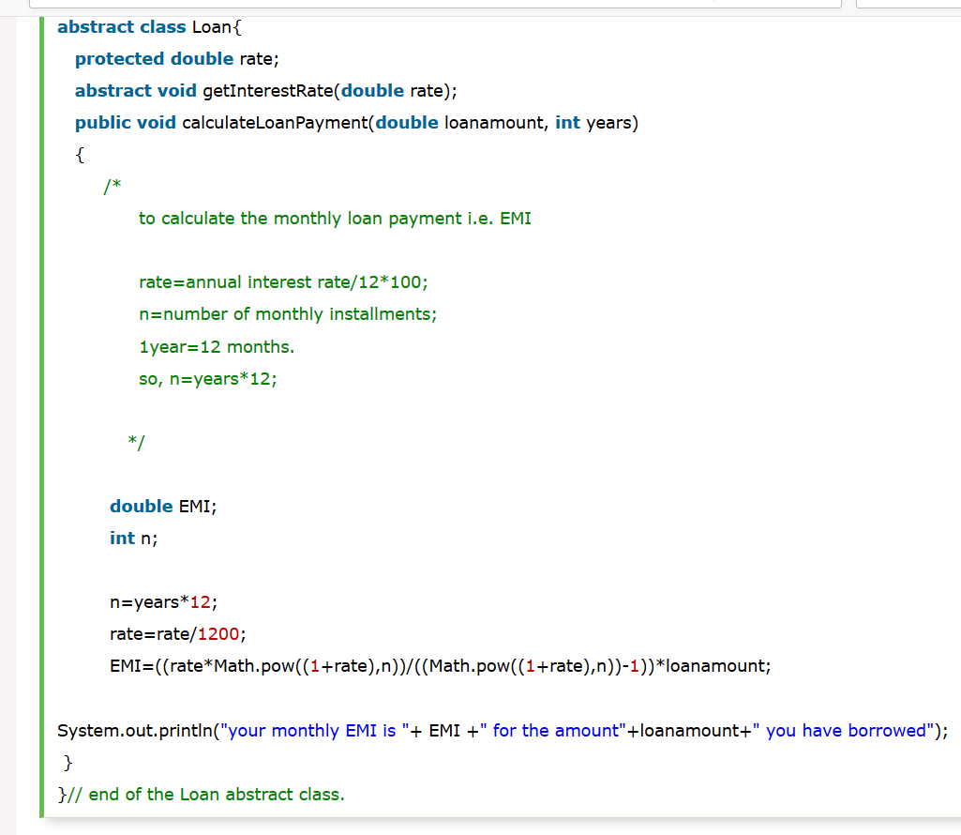

Slide 22
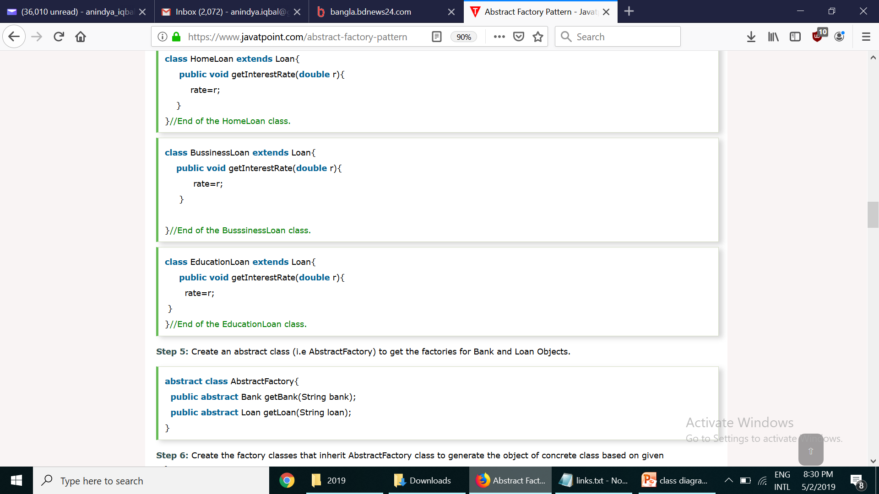
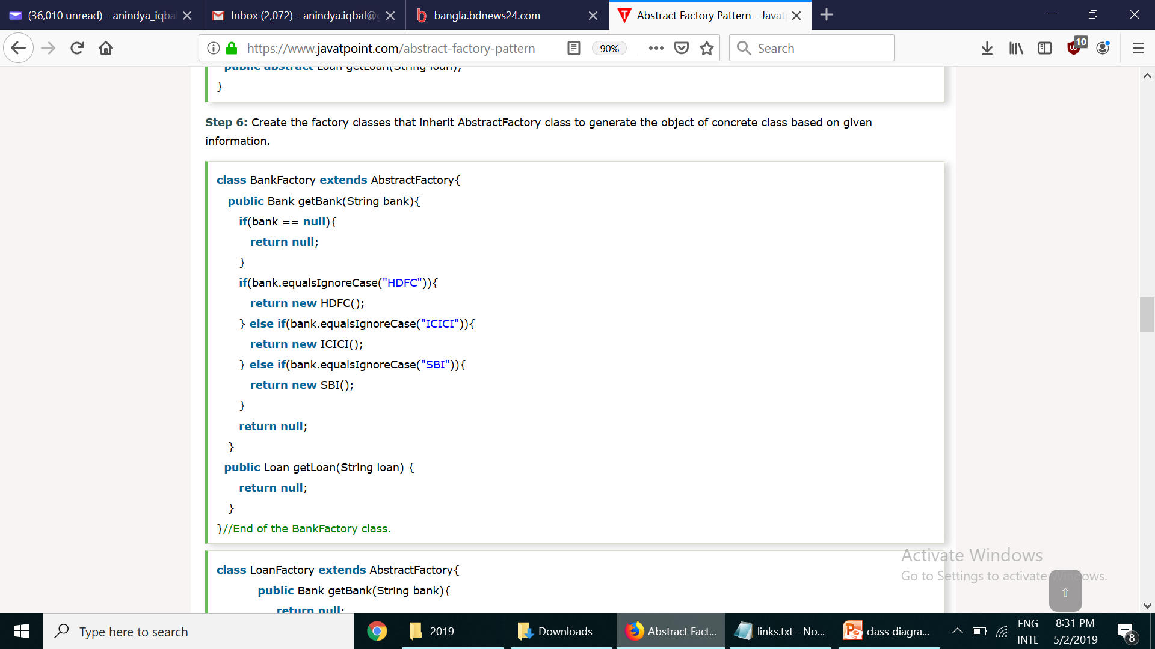

Slide 23
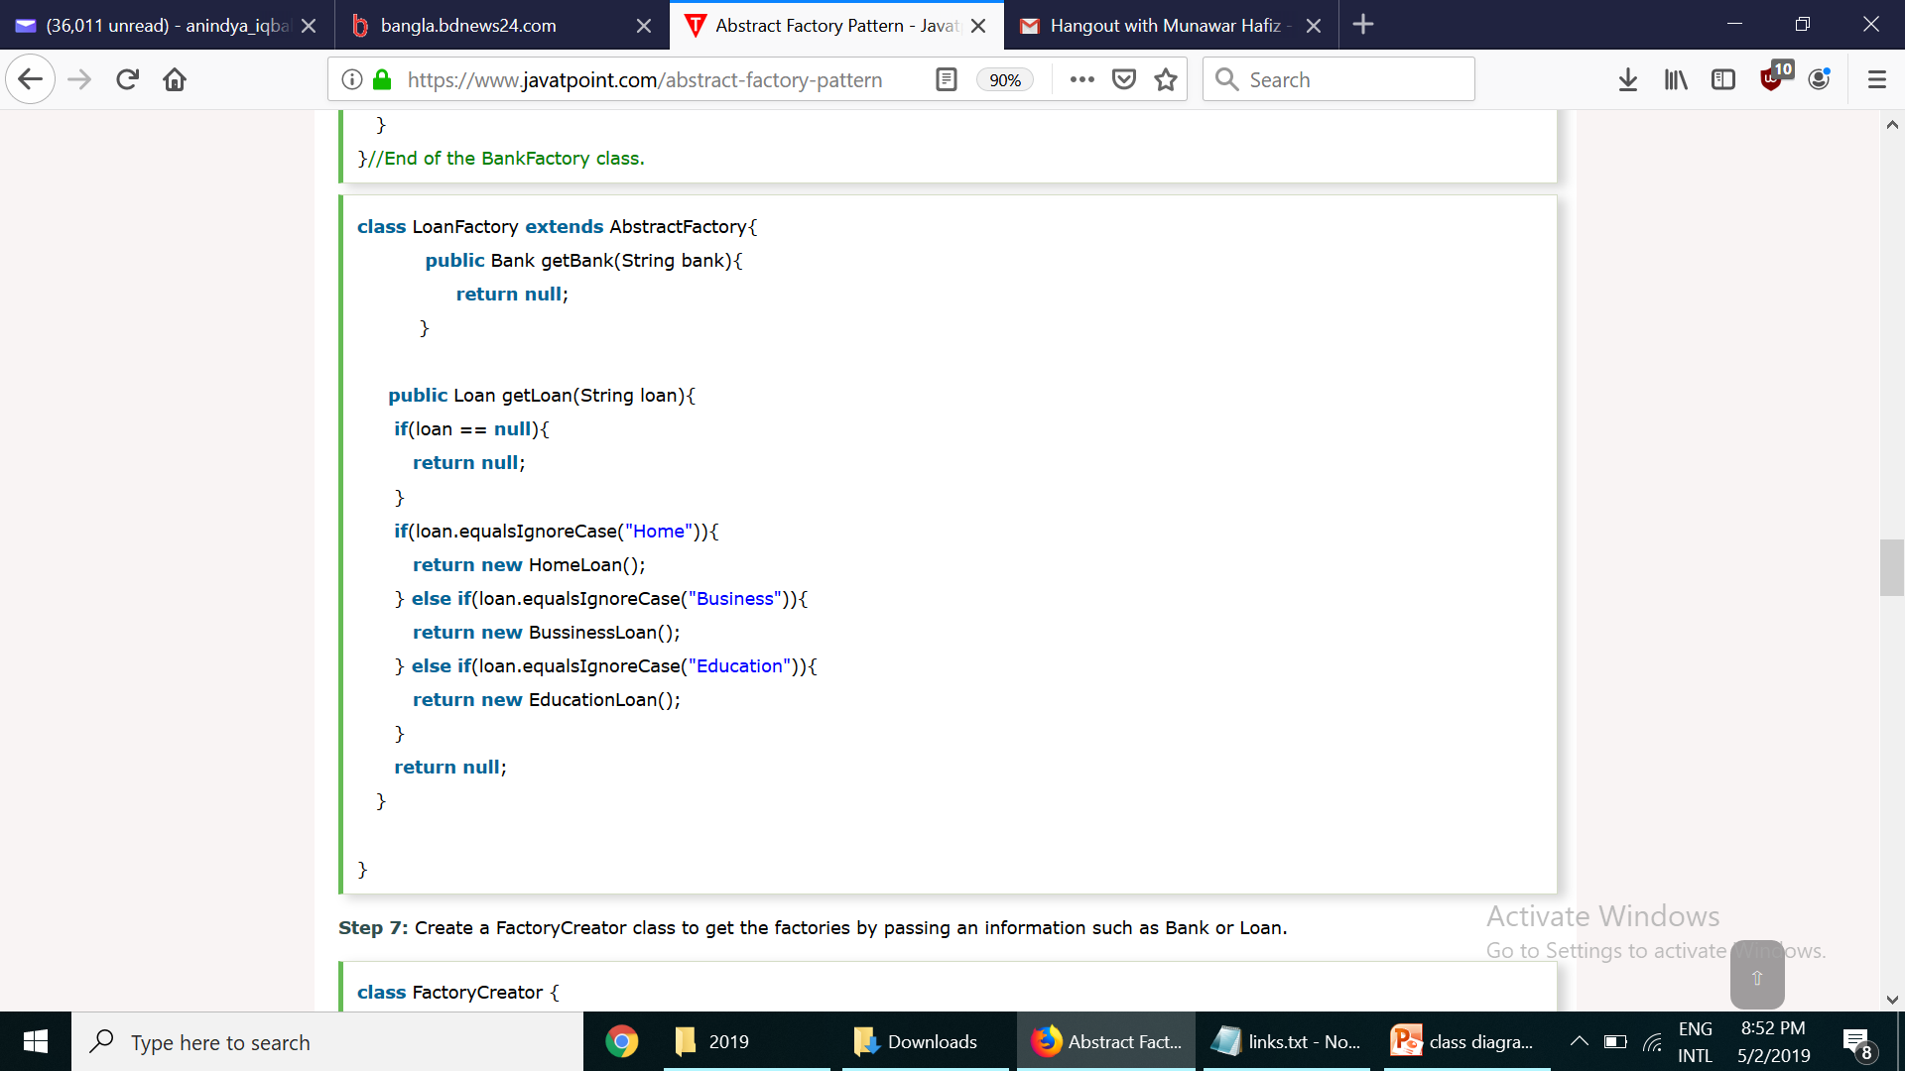
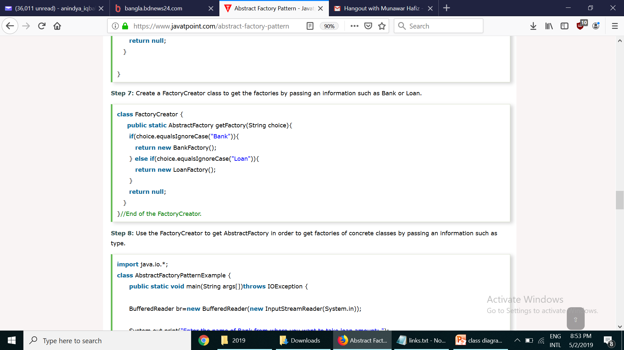

Slide 24
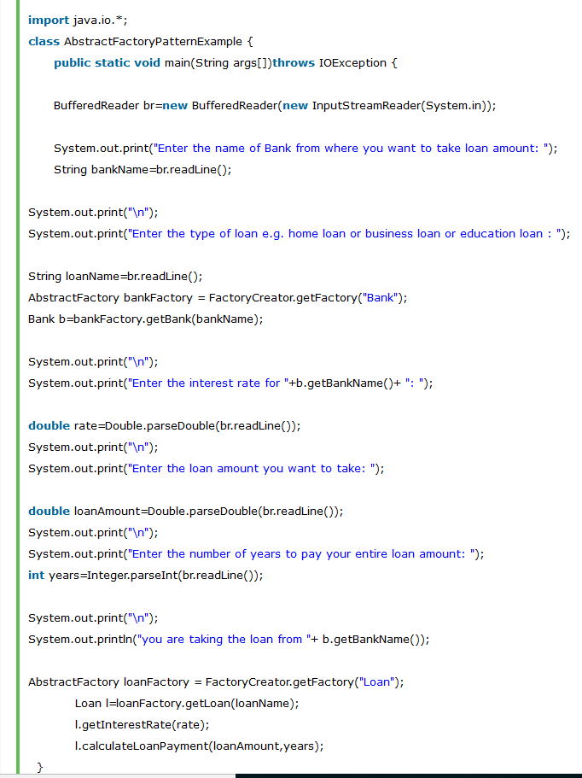

Slide 25
Consequences
Isolates the concrete class
Makes exchanging product family easy
Promotes consistency among products
Abstract Factory design pattern provides approach to code for interface rather than implementation.
Abstract Factory pattern is “factory of factories” and can be easily extended to accommodate more products.
Abstract Factory pattern is robust and avoid conditional logic of Factory pattern.
Supporting new types of products is difficult

Slide 26
Singleton
Intent | Ensure a class has only one instance, and provide a global point of access to it. Encapsulated "just-in-time initialization" or "initialization on first use".
Problem | Application needs one, and only one, instance of an object. Additionally, lazy initialization and global access are necessary.

Slide 27
Solution
SingletonClass
- instance: SingletonClass
- SingletonClass()
+ getInstance(): SingletonClass

Slide 28
Example: DB Connection Manger
public class DbConnection{
private static DbConnection instance=null;
private SQLConnection connection;
private DbConnection() {
connection = connectToDatabase(dbUser,dbPassword,dbName);
}
public static getDbConnection() {
if (instance== null )
instance = new DbConnection() ;
return instance;
}
}
DbConnection connection=DbConnection.getDbConnection();

Slide 29
Consequences
Controlled access to sole instance
Reduced namespace
Permits variable number of instances

Slide 30
Builder
Intent | Separate the construction of a complex object from its representation so that the same construction process can create different representations. Parse a complex representation, create one of several targets.
Problem | An application needs to create the elements of a complex aggregate. The specification for the aggregate exists on secondary storage and one of many representations needs to be built in primary storage.

Slide 31
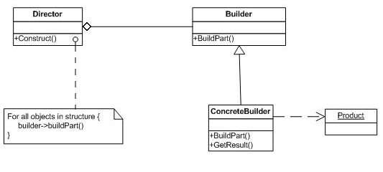
Solution

Slide 32
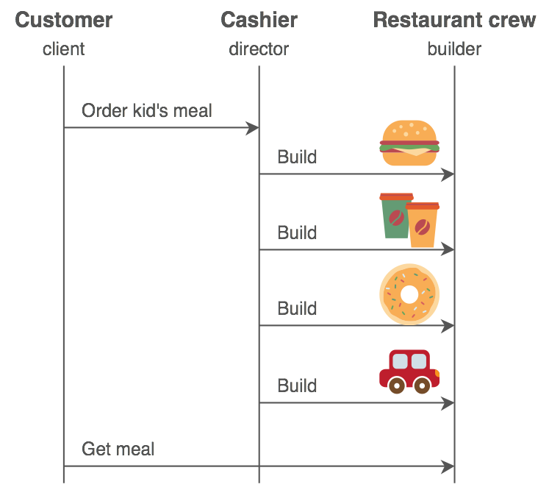
Examples
To create a computer, different parts are assembled depending upon the order received by the customer
(e.g., a customer can demand a 500 GB hard disk with an Intel processor; another customer can choose a 250
GB hard disk with an AMD processor).

Slide 33
Consequences
Lets you vary a product’s internal representation
Isolates construction and representation
Gives you finer control over the construction process

Slide 34
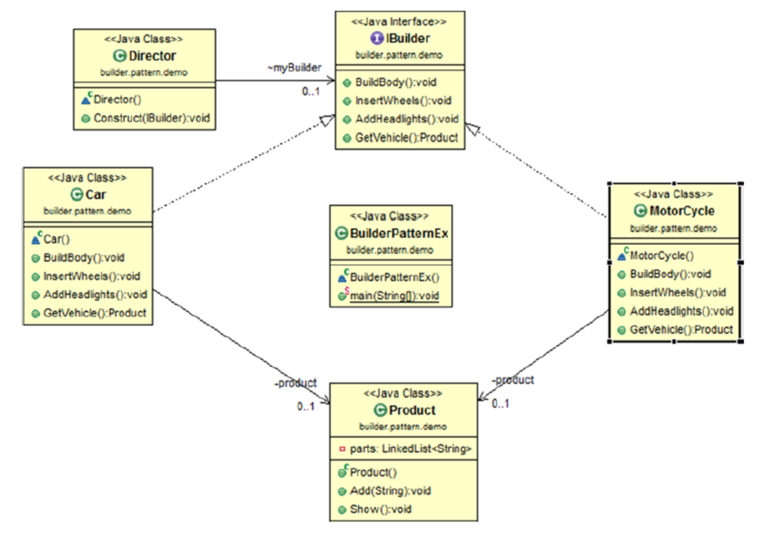

Slide 35
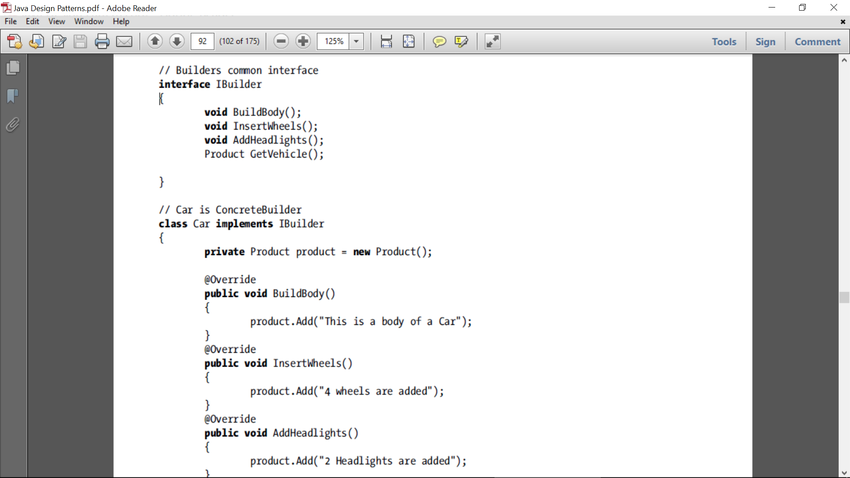
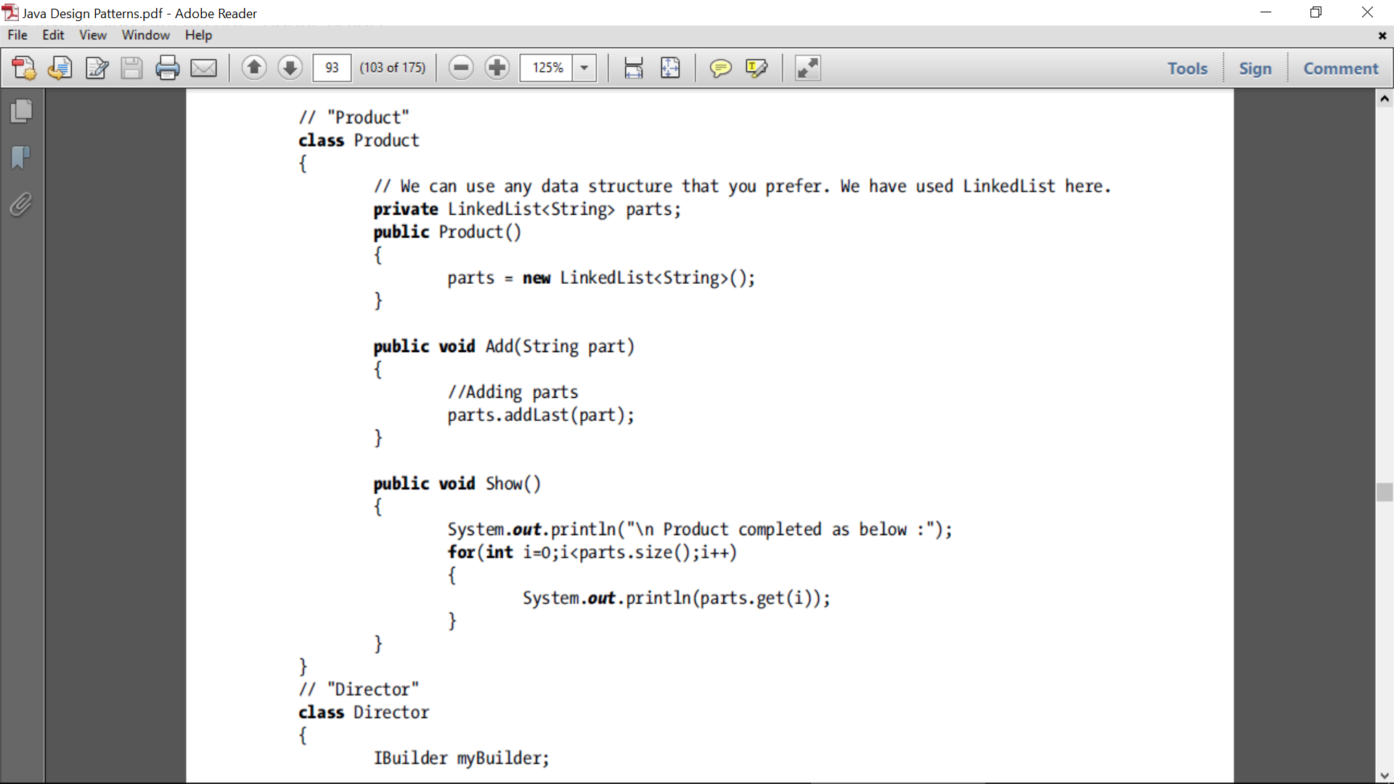
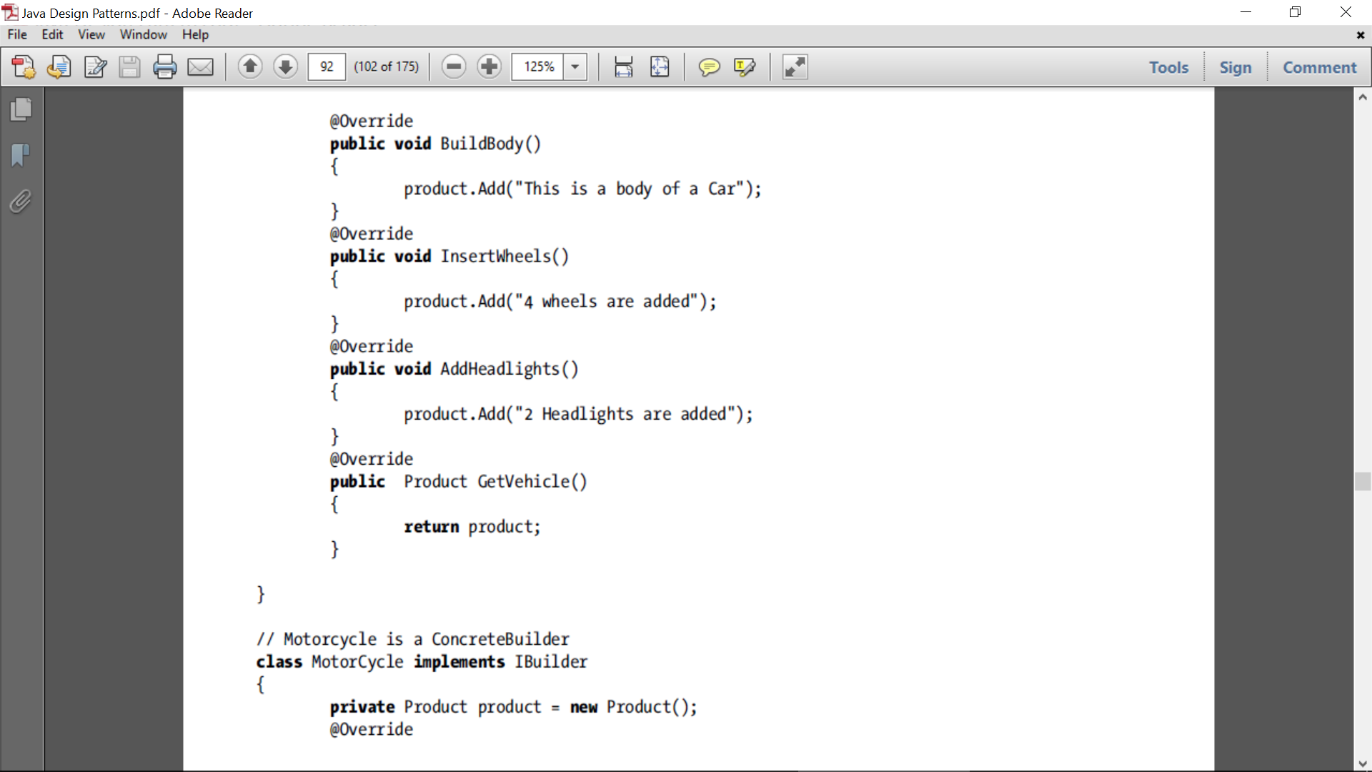

Slide 36
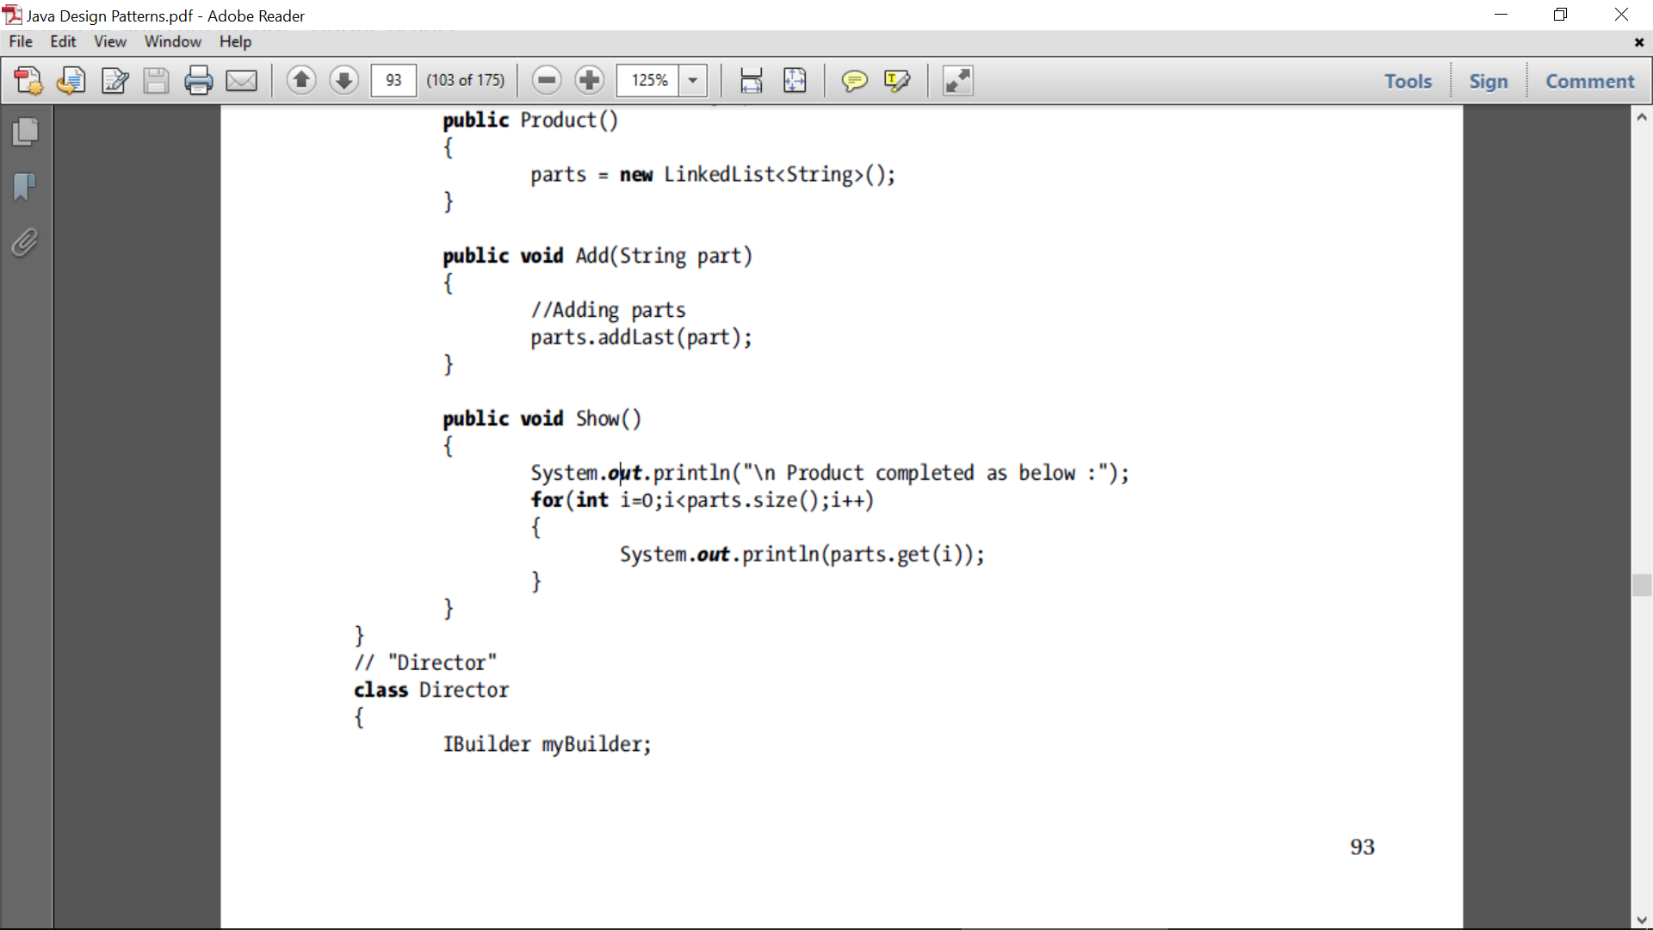
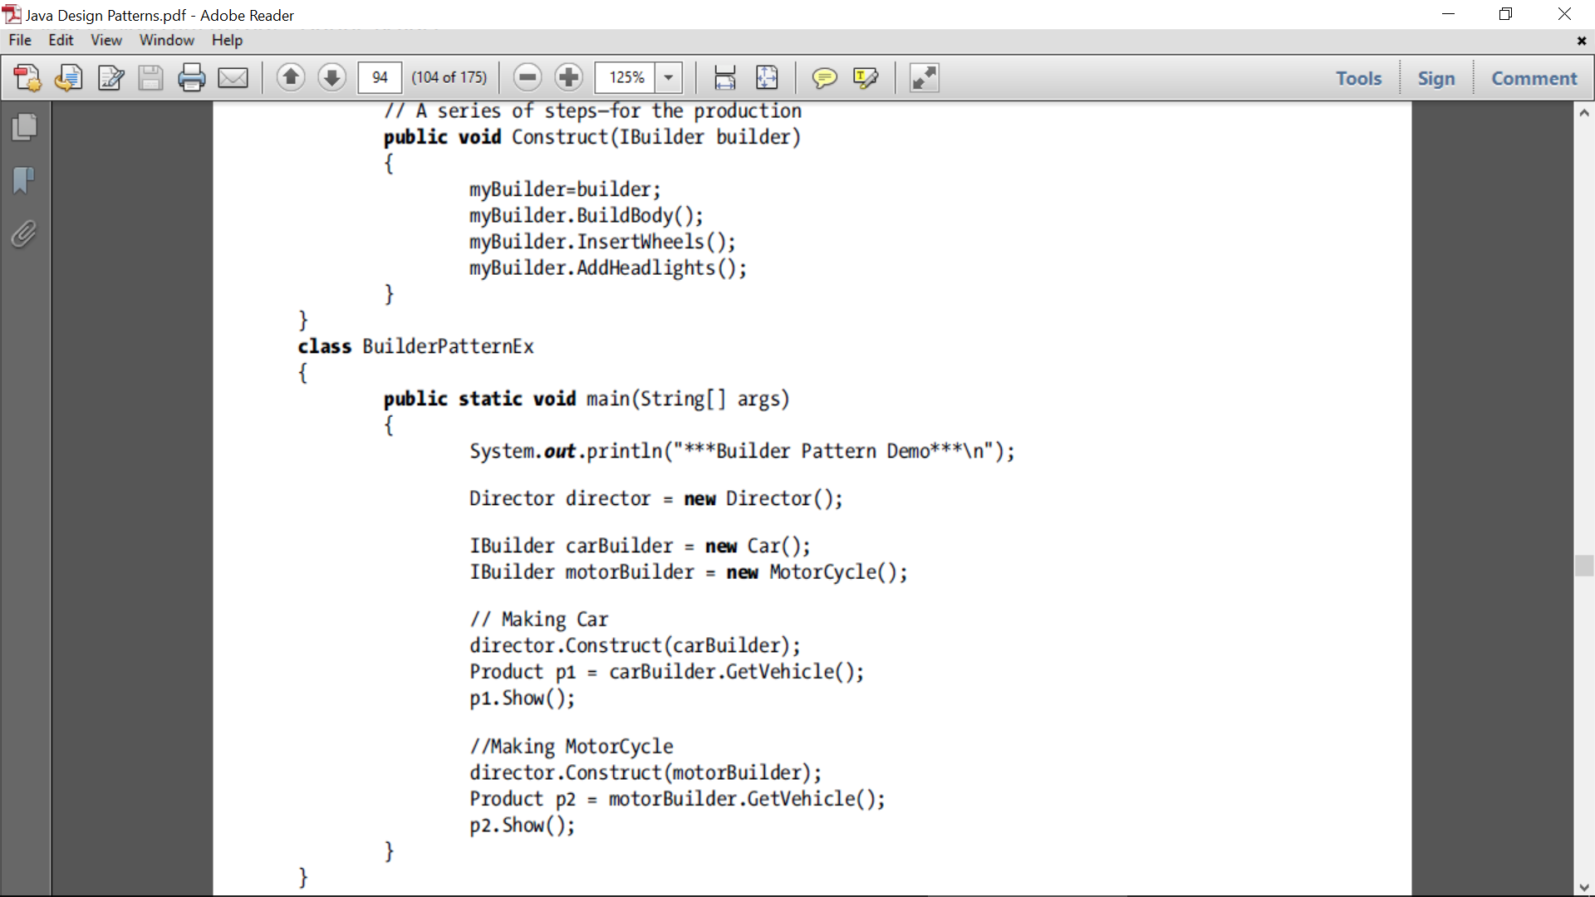

Slide 37
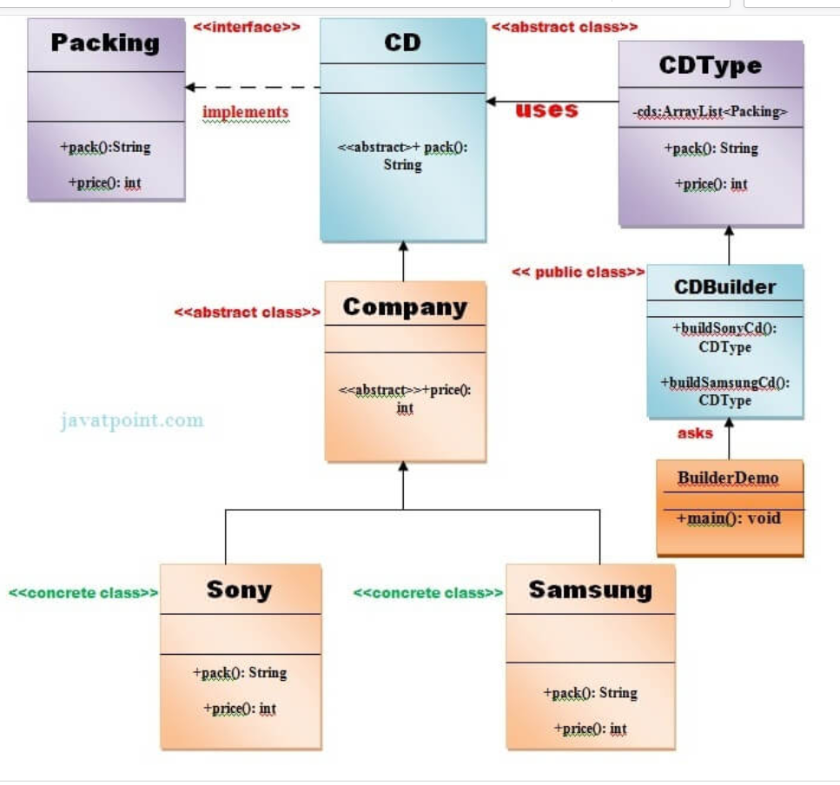
Builder

Slide 38
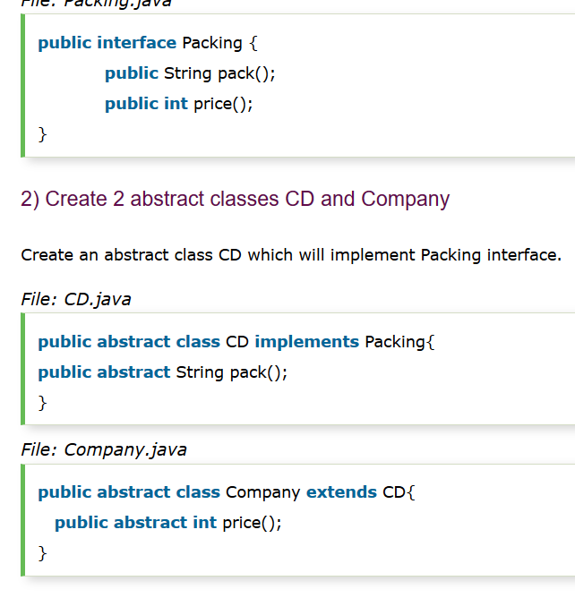

Slide 39
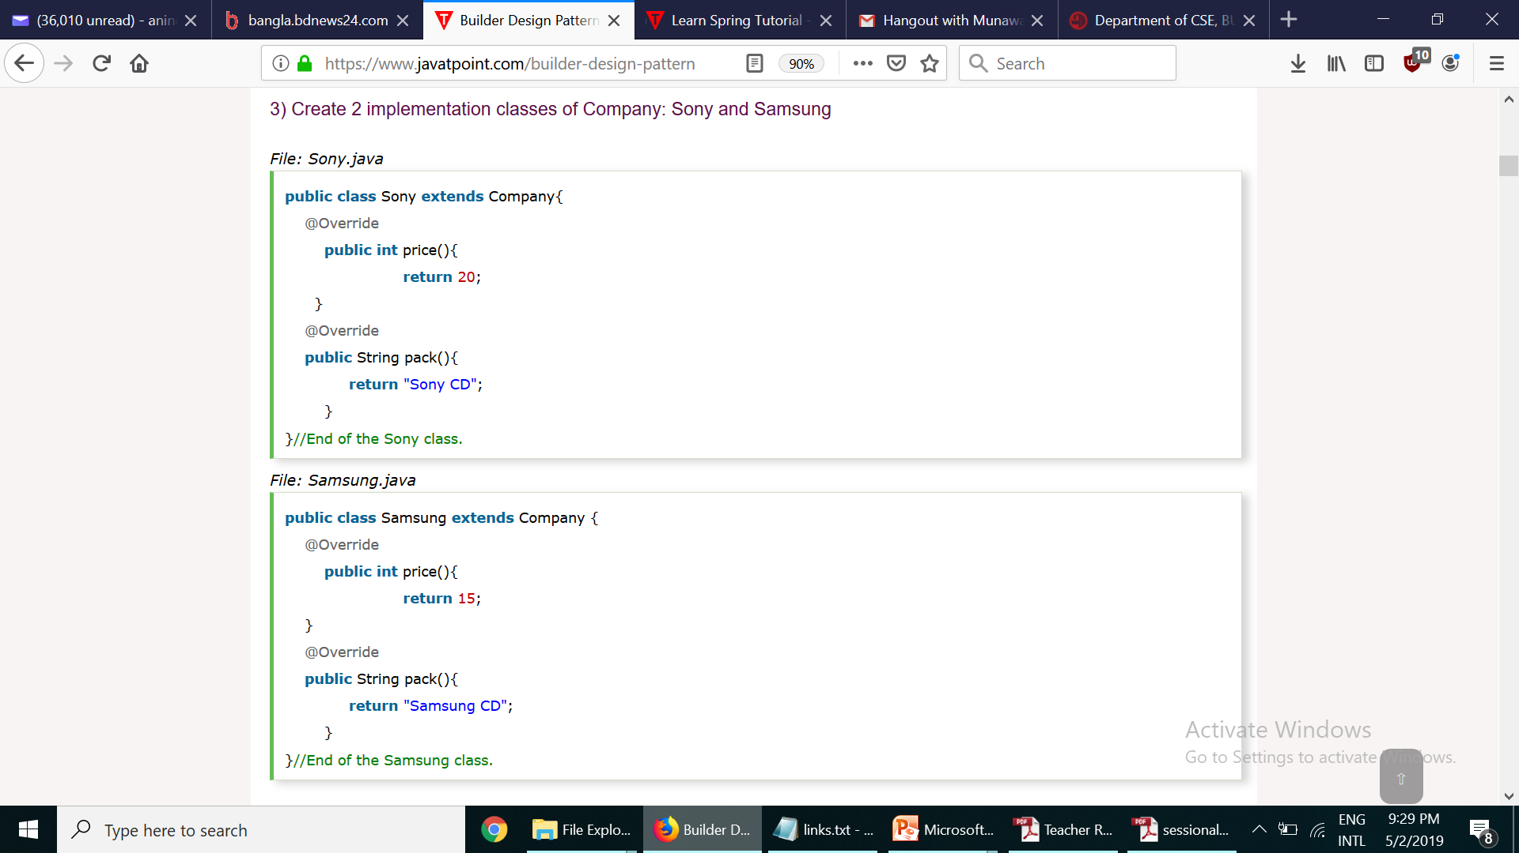
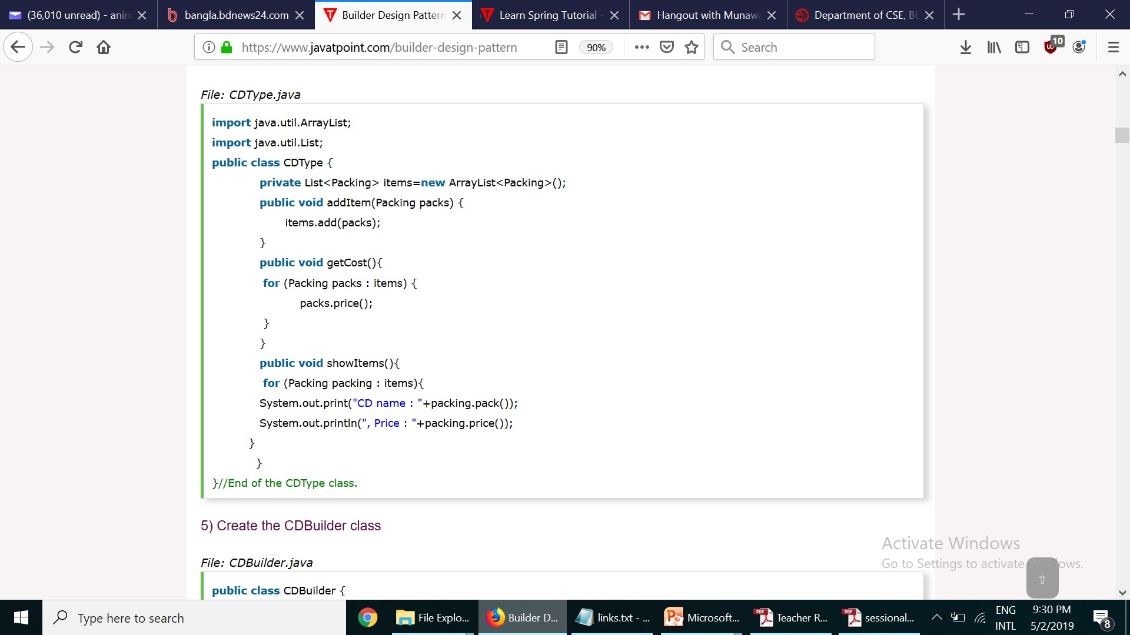

Slide 40
